Slide 1

OGC Linters
Code Sprint London 2024
Joost Farla, Frank Terpstra

Slide 2
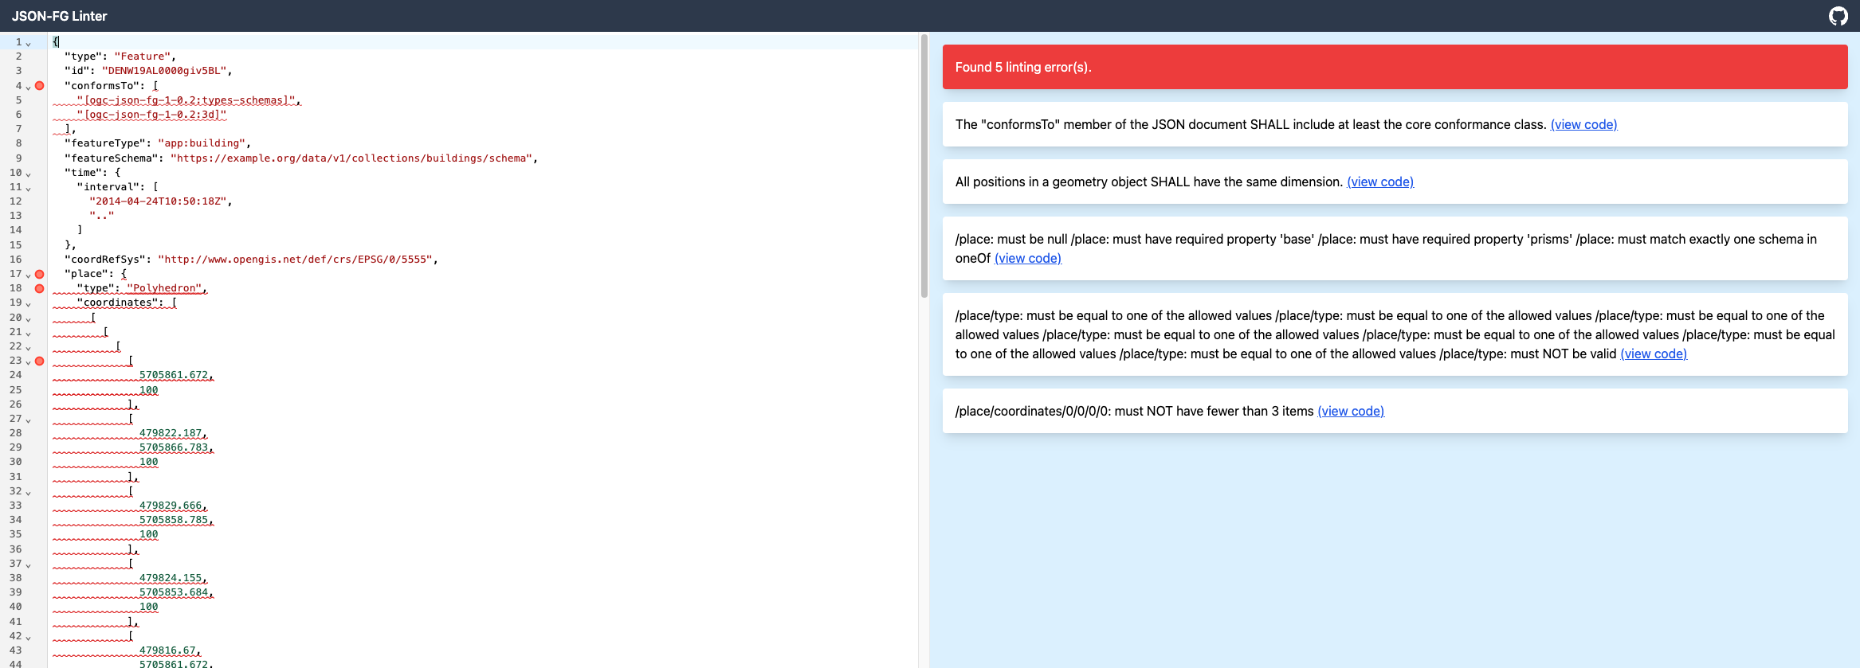
Previous work (Evora code sprint)
JSON-FG Linter
https://geonovum-labs.github.io/json-fg-linter/
Improvements for JSON-FG spec

Slide 3
Plans
Complete coverage for JSON-FG Linter
Validate OpenAPI documents against API Features standards
Run in the browser & server-side
IDE integration (LSP: Language Server Protocol)

Slide 4
Thank you!

